Slide 1
Project on Movie Recommendation System
Created By – Himanshu Bhatt

Slide 2
Topics Covered
Recommendation System
Content Based System
Why Movie Recommendation System
Overview of Tasks Performed
Software Requirements
Data Flow Diagram
Activity Diagram
Future Scope

Slide 3
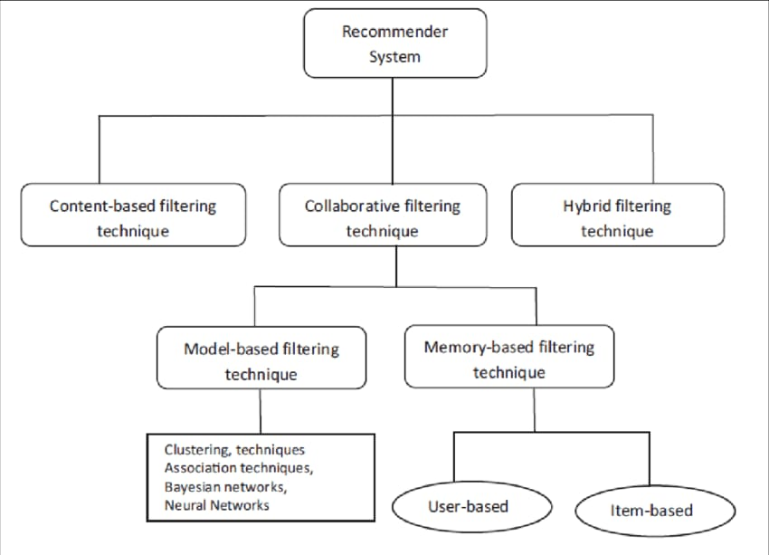
Recommendation System Recommendation system is an artificial intelligence or AI algorithm, usually associated with machine learning, that uses Big Data to suggest or recommend additional products to consumers

Slide 4
Content Based Technique
This technique method tries to create a model based on user’s features or even information about items.
These features could be age, Sex, Job, nationality, genre of a movie, the director, or any other personal features about users/products.
Example, given game genre information, and knowing that a player liked “GTA ” and “Free-Fire” games one may infer that the player prefers playing actions and open world games, and could hence recommend “PUBG” game.

Slide 5
Collaborative Technique
The goal of this approach is offering consumers products they have not yet seen, based on the rating history and tastes of similar user profiles, the similarity between different consumers as well as products(items, videos, pages, books) that are used in recommendation system.
So, Collaborative Filtering has been employed accurately and quickly in recommendations without seen any information about product(item) itself.
There are two main categories for Collaborative Filtering: Memory-based and Model-based method.
The Memory-based methods utilize directly the data that obtained form consumers to measure the affinity b/w consumers or products to predict the recommendations.
The Model-based technique uses only those data from consumers, which enhance the efficiency of method implementation and make it easier.

Slide 6
Why Movie Recommendation System
Building a project on a movie recommendation system can be rewarding and interesting endeavor for several reasons:
Popularity and demand: Movie recommendation systems are widely used by streaming platforms like Netflix, Amazon Prime Video, and Hulu to enhance user experience and engagement. With the rise of streaming services and the increasing amount of available content, there is a growing demand for personalized movie recommendations.
Applicability and real-world relevance : Movie recommendation systems are a practical application of machine learning and data science techniques. By building a movie recommendation system, you can gain hands-on experience with popular algorithms and methodologies used in the field.
Rich dataset availability : Movie databases such as IMDb, TMDb (The Movie Database), and MovieLens provide extensive data on movies, including genres, ratings, release dates, and user reviews. These datasets offer a valuable resource for training and evaluating recommendation models.
Personalization challenge Personalization challenge: Recommending movies to users based on their preferences is a complex problem, as it involves understanding their unique tastes and interests. Designing and implementing an effective recommendation system requires solving challenges like data sparsity, cold start problem, and building accurate user profiles. Overcoming these challenges can be intellectually stimulating.

Slide 7
Overview of Tasks Performed
Data Collection and Integration
Data Preprocessing
Model Training and Testing
Developing UI

Slide 8
Software Required
Text Editor
VS Code
Jupyter Notebook
Python Libraries and Packages
NumPy
Pandas
Sklearn
Pickle
Python Framework
Streamlit

Slide 9
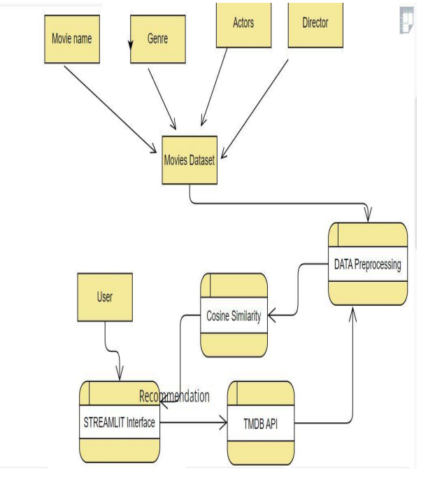
Data Flow Diagram

Slide 10
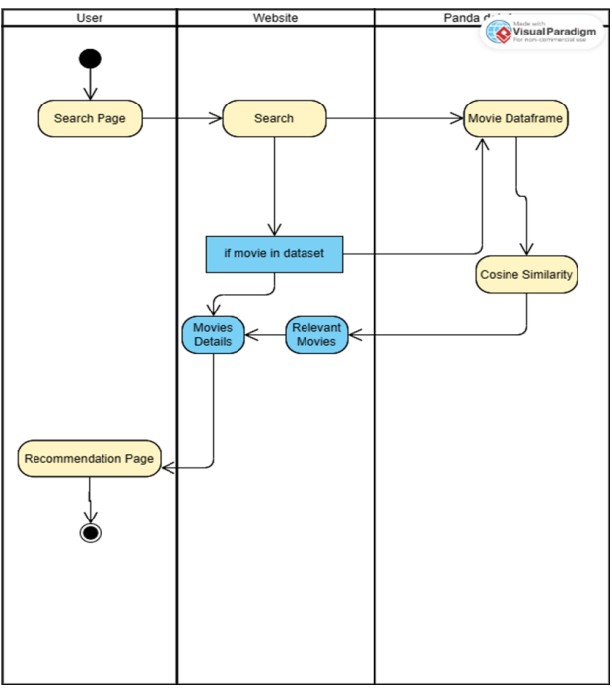
Activity Diagram

Slide 11
Future Scope
Scaling up resources will allow more people to use the website.
Adding reviews to upcoming movies.
Adding short videos about movies.
Adding weekly trending and Best of all time section and more.
Improving the overall security of the project will allow it to be used commercially.

